Slide 1
Hospital Corporation of America Account Deep Dive Analysis August 2025

Slide 2








Company Overview and Financial Summary
HCA Healthcare provides medical education and healthcare services in locally managed facilities.
Company Overview
Year of Establishment
Headquarters
Employees
Revenue
(FY 2024)
1968
Greater Nashville, Tennessee Area, United States
~226,000
70603.0 USD Million
Revenue (FY 2020 - 2024)
Revenue share by Geography (FY 2024)
Revenue share by Segments (FY 2024)
Revenue CAGR
(FY 2020 - 2024)
Financial
Snapshot
8.19%
Revenue in USD Million

Slide 3
Account Priorities: Healthcare Operations
Business Function | Account Priority | Applicable Use Cases | Workloads
Healthcare Operations | Improving Quality Outcomes and Patient Throughput | • AI-powered Healthcare Automation • Cloud-based Digital Healthcare System • AI-driven Patient Transport Optimization | • Hospital Admin & Support Services • Nursing • Therapeutic
 | HCA Healthcare is prioritizing enhancements in clinical quality outcomes and operational efficiency, particularly in emergency room throughput and patient satisfaction metrics. These improvements reflect the company’s commitment to delivering high-quality patient care while maintaining efficient healthcare operations across its network.
Healthcare Operations | Recovery and Performance Improvement in Hurricane-Impacted Markets | • Medical Surge Forecasting using Predictive Analytics • Cloud-based Covid Contact Tracing • Interactive Geo-map Forecasting for COVID Cases | • Hospital Admin & Support Services • Therapeutic • Diagnostic
 | The company is focused on the ongoing recovery of facilities affected by Hurricanes Helene and Milton in 2024, with progress exceeding initial expectations. Simultaneously, HCA is addressing underperforming markets with tailored operational plans to improve overall portfolio performance and offset challenges in specific regions.
Healthcare Operations | Network Development and Capacity Expansion | • AI-based Hospital Resource Planning • AI-driven Patient Transport Optimization • WIFI-enabled Hospitals | • Hospital Admin & Support Services • Nursing • Physicians & Surgeons
 | HCA Healthcare is expanding its network by increasing the number of facilities by 3.3% and enhancing inpatient bed capacity by approximately 2%. This strategic growth aims to meet the rising demand for healthcare services and improve access for communities.
Note: The mentioned data are not exhaustive

Slide 4
Account Priorities: Healthcare Operations
Business Function | Account Priority | Applicable Use Cases | Workloads
Healthcare Operations | Expanding Capacity and Access to Care | • AI-based Hospital Resource Planning • Autonomous Vehicle for Telehealth Service • Interactive Digital Roadmap for Healthcare | • Hospital Admin & Support Services • Nursing • Therapeutic
 | HCA is investing approximately $6 billion in projects to add around 600 inpatient beds and 100 new outpatient facilities by the end of the year. These initiatives aim to enhance service delivery and meet the growing demand for healthcare services across its networks.
Healthcare Operations | Strengthening Emergency Room Services | • AI-based Patient & Workflow Management • AI-driven Patient Transport Optimization • Patient Queue Management App | • Hospital Admin & Support Services • Nursing • Diagnostic
 | The organization continues to invest in emergency room optimization to improve patient outcomes and service delivery. Emergency room visits have shown consistent growth, indicating a strong demand for these services in the communities served.
Healthcare Operations | Expansion of Emergency Medical Services in North Walton County | • Patient Queue Management App • Autonomous Vehicle for Telehealth Service • 5G Connected Ambulance | • Hospital Admin & Support Services • Physicians & Surgeons • Nursing
 | HCA Healthcare is investing $19 million to construct a new 11,000 square-foot freestanding emergency room in DeFuniak Springs, Florida, scheduled to open in early 2026. This facility will provide 24/7 full-service emergency care staffed by board-certified emergency medicine physicians and nurses, equipped with advanced diagnostic services including CT scan, digital X-ray, ultrasound, and on-site laboratory capabilities to enhance timely and high-...
Note: The mentioned data are not exhaustive

Slide 5
Account Priorities: Healthcare Operations
Business Function | Account Priority | Applicable Use Cases | Workloads
Healthcare Operations | Integration and Expansion of Acute Care Hospitals in New Hampshire | • Hospital Automated Guided Vehicles (AGVs) • AI-based Hospital Resource Planning • Autonomous Vehicle for Telehealth Service | • Hospital Admin & Support Services • Nursing • Physicians & Surgeons
 | Following the acquisition of Concord Medical Center (CMC), HCA now operates four of the 26 acute care hospitals in New Hampshire, expanding its regional healthcare footprint. This transition from nonprofit to for-profit status impacts regulatory obligations related to charity care and community health services, while enabling HCA to enhance access to obstetrics and gynecology services through new physician deliveries at CMC.
Healthcare Operations | Enhancement of Nursing Workforce Conditions and Retention | • Smart Beds • Wearable Badges for Handwash Reminder • Robotic Nurses | • Nursing • Hospital Admin & Support Services • Therapeutic
 | At HCA’s Good Samaritan Hospital in San Jose, California, registered nurses ratified a new five-year contract that includes significant wage increases up to 45% for some nurses over the contract term. The agreement also introduces improved break relief provisions, protections against workplace violence, and safeguards preventing replacement of nurses by technology, reflecting HCA’s commitment to workforce stability and safe working conditions.
Healthcare Operations | Recognition and Engagement Initiatives for Clinical and Ancillary Staff | • Wearable Badges for Handwash Reminder • Smart Wards • Intelligent Nurse Station Systems | • Nursing • Hospital Admin & Support Services • Pharmacy
 | HCA Florida Fort Walton Destin Hospital has implemented DAISY Foundation awards for nursing staff and Sunflower awards for ancillary personnel to recognize outstanding contributions. New leadership is prioritizing cross-departmental feedback to identify organizational needs and challenges, fostering a culture of engagement and continuous improvement in patient care delivery.
Note: The mentioned data are not exhaustive

Slide 6
Account Priorities: Management & Strategy
Business Function | Account Priority | Applicable Use Cases | Workloads
Management & Strategy | Leveraging National and Local Network Synergies | • Data-driven Strategic Market Expansion • AI-based Government Contract Optimization • AI-driven Capital Investment Optimization | • Corporate Strategy & Management Consulting • Leadership & Governance • Governance, Risk & Compliance
 | HCA Healthcare aims to reinforce its competitive position by combining the strengths of its high-quality local health networks with the capabilities of a national system. This strategic approach enables the company to respond effectively to evolving market dynamics and meet diverse patient needs across its footprint.
Management & Strategy | Innovation Through Technology and Efficiency Initiatives | • Blockchain-enhanced e-waste Management • App based Overexertion Risk Control • AI-based Government Contract Optimization | • Leadership & Governance • Corporate Strategy & Management Consulting • Governance, Risk & Compliance
 | The organization is relentlessly pursuing innovation by integrating technology to improve operational efficiencies and accountability. This includes identifying new ways to enhance processes and deliver results aligned with the company’s mission and stakeholder expectations.
Management & Strategy | Strategic Response to Federal Policy Environment | • Benefit Processing Automation for Citizens • AI-based Government Contract Optimization • Data-driven Strategic Market Expansion | • Governance, Risk & Compliance • Corporate Strategy & Management Consulting • Leadership & Governance
 | HCA Healthcare is actively monitoring and adapting to changes in the federal policy landscape, including the Medicaid provisions of the One Big Beautiful Bill Act and potential expiration of premium tax credits. The company is preparing to adjust its strategies as needed to mitigate risks and capitalize on grandfathering provisions and state-directed payment programs.
Note: The mentioned data are not exhaustive

Slide 7
Account Priorities: Management & Strategy
Business Function | Account Priority | Applicable Use Cases | Workloads
Management & Strategy | Implementing Resiliency Programs for Long-Term Growth | • App based Overexertion Risk Control • AI-driven Capital Investment Optimization • AI-based Government Contract Optimization | • Corporate Strategy & Management Consulting • Governance, Risk & Compliance • Corporate Social Responsibility
 | HCA is leveraging its resiliency program to achieve $600 million to $800 million in savings, which will support investments in technology and innovation. This program aims to enhance operational efficiency and maintain strong margins while navigating challenges in the healthcare landscape.
Management & Strategy | Strategic Planning for 2025 and Beyond | • Data-driven Strategic Market Expansion • AI-driven Capital Investment Optimization • Intelligent Face-off Prediction | • Corporate Strategy & Management Consulting • Leadership & Governance • Governance, Risk & Compliance
 | The organization is in the process of developing its strategic outlook for 2025, with expectations of continued volume growth and a stable operating environment. Preliminary views suggest earnings growth near or slightly above long-term targets, factoring in the ongoing impacts of recent hurricanes.
Management & Strategy | Board Expansion to Strengthen Governance and Operational Expertise | • Data-driven Strategic Market Expansion • App based Overexertion Risk Control • Proxy Voting System for Investors | • Governance, Risk & Compliance • Leadership & Governance • Corporate Strategy & Management Consulting
 | HCA Healthcare expanded its Board of Directors from nine to ten members with the appointment of John W. Chidsey, III, effective July 15, 2025. Chidsey brings extensive experience in operational scalability, financial governance, and regulatory compliance, serving on key board committees including Audit and Compliance, Compensation, and Patient Safety and Quality of Care, supporting HCA’s strategic focus on governance rigor and ESG demands.
Note: The mentioned data are not exhaustive

Slide 8
Account Priorities: Management & Strategy
Business Function | Account Priority | Applicable Use Cases | Workloads
Management & Strategy | Strengthening Community Impact through Healthier Tomorrow Fund Grants | • App based Overexertion Risk Control • Gambling Addiction Prevention using AI • Benefit Processing Automation for Citizens | • Governance, Risk & Compliance • Leadership & Governance • Corporate Strategy & Management Consulting
 | The HCA Healthcare Foundation is expanding its partnership with Educate Texas via a $1 million grant through the Healthier Tomorrow Fund to support workforce development in healthcare. This initiative focuses on creating career pathways in high-demand healthcare fields, exemplified by support for the P-TECH high school program, aligning education with workforce needs to build a stronger healthcare talent pipeline.
Management & Strategy | Strategic Financial Performance Monitoring | • Data-driven Strategic Market Expansion • AI-driven Capital Investment Optimization • Automated Supplier Risk Assessment | • Corporate Strategy & Management Consulting • Governance, Risk & Compliance • Leadership & Governance
 | HCA Healthcare is focused on monitoring its overall stock performance, emphasizing strong revenue growth and cash flow generation. The organization aims to address challenges related to declining profit margins and high leverage through strategic financial planning and risk management.
Management & Strategy | Community Health Collaboration | • Community Engagement Platform • Blockchain-based CSR Accountability • AI-based Sustainable Energy Transition | • Leadership & Governance • Corporate Social Responsibility • Corporate Strategy & Management Consulting
 | HCA Healthcare has launched the United for Healthy Starts initiative, a collaboration with multiple United Ways to enhance access to essential support services for families. This strategic effort aims to improve health outcomes for mothers and young children, particularly those facing significant barriers.
Note: The mentioned data are not exhaustive

Slide 9
Account Priorities: Finance & Accounting
Business Function | Account Priority | Applicable Use Cases | Workloads
Finance & Accounting | Capital Allocation for Long-Term Value Creation | • AI-driven Capital Investment Optimization • Cloud-based Financial Planning and Analysis • Financial Planning Dashboard | • Financial Planning & Analysis • Fixed Asset Management • Treasury & Risk
 | HCA Healthcare is focused on a balanced capital allocation strategy aimed at long-term value creation. In Q2 2025, the company deployed $1.2 billion in capital expenditures, $2.5 billion in share repurchases, and $171 million in dividends, reflecting a disciplined approach to managing financial resources. The company also benefited from tax relief measures, such as deferring approximately $850 million in tax payments due to IRS relief after sever...
Finance & Accounting | Financial Resiliency Programs to Offset Policy and Market Risks | • AI-based Insurance Calculation • AI-Powered Revenue Cycle Management • Cloud-based Financial Planning and Analysis | • Treasury & Risk • Financial Planning & Analysis • Accounts Payable
 | HCA Healthcare is actively developing and executing financial resiliency programs to mitigate potential adverse impacts from federal policy changes, including the expiration of enhanced premium tax credits and Medicaid-related provisions in the One Big Beautiful Bill Act. These programs are designed to offset revenue risks associated with potential insurance coverage losses and changes in supplemental payment programs, ensuring the company mainta...
Finance & Accounting | Optimizing Payer Mix and Revenue Growth | • Predictive Revenue Cycle Analytics • AI-Powered Revenue Cycle Management • Cloud-based Accounts Receivable Automation | • Financial Planning & Analysis • Accounts Payable • Accounts Receivable
 | The company is strategically managing its payer mix to drive revenue growth, with a focus on increasing managed care equivalent admissions and improving patient acuity levels. Despite slight declines in Medicaid and Medicare volumes, HCA Healthcare achieved a 6.4% revenue growth in Q2 2025, slightly above guidance, supported by improved payer mix and consistent patient acuity.
Note: The mentioned data are not exhaustive

Slide 10
Account Priorities: Finance & Accounting
Business Function | Account Priority | Applicable Use Cases | Workloads
Finance & Accounting | Enhancing Financial Resilience Post-Hurricane | • Predictive Revenue Cycle Analytics • Medical Procedure Cost Estimation • Cloud-based Financial Planning and Analysis | • Financial Planning & Analysis • Treasury & Risk • Accounts Payable
 | HCA Healthcare is focused on managing financial impacts from recent hurricanes, estimating additional expenses and lost revenue in the range of $200 million to $300 million for Q4 2024. The organization is actively working on insurance claims related to these events, although specific recovery amounts and timelines remain uncertain.
Finance & Accounting | Establishment of Commercial Paper Program to Enhance Financial Flexibility | • Cloud-based Back-office Automation • Cloud-based Insurance Accounting • Cloud-based Hospitality Accounting Management System | • Treasury & Risk • Fixed Asset Management • General Accounting
 | HCA Healthcare has launched a new commercial paper program through its wholly owned subsidiary, HCA Inc., backed unconditionally by the parent company. This program provides HCA with increased financial flexibility by enabling access to short-term funding for general corporate purposes, supporting ongoing operations and strategic initiatives.
Finance & Accounting | Compensation Program Implementation | • Blockchain-based Treasury Management • Accounts Payable and Receivable Automation • Blockchain-based e-Invoicing Processing | • Fixed Asset Management • Treasury & Risk • Accounts Payable
 | The organization has approved a new compensation program for non-management directors, focusing on cash retainers and equity awards to align interests with long-term performance. This initiative aims to enhance governance and attract qualified board members while ensuring compliance with regulatory standards.
Note: The mentioned data are not exhaustive

Slide 11
Account Priorities: Finance & Accounting, Human Resources
Business Function | Account Priority | Applicable Use Cases | Workloads
Finance & Accounting | Public Offering of Senior Notes | • Cloud-based Financial Planning and Analysis • Cloud-based Treasury System • Cloud-based Back-office Automation | • Financial Planning & Analysis • Treasury & Risk • General Accounting
 | HCA Healthcare, Inc. plans to propose a public offering of senior notes through its subsidiary, HCA Inc., to support general corporate purposes. The net proceeds from this offering may be utilized for repaying existing borrowings or future credit facilities, depending on market conditions.
Finance & Accounting | Investment in Strategic Partnerships | • AI-driven Capital Investment Optimization • Cloud-based Financial Planning and Analysis • Financial Planning Dashboard | • Financial Planning & Analysis • Fixed Asset Management • Treasury & Risk
 | HCA Healthcare is focusing on strategic investments to enhance its financial portfolio, including equity investments in innovative healthcare companies. This approach aims to support the development of new technologies and services that align with HCA's mission to improve patient care.
Human Resources | Investment in Workforce Development | • AI-driven Hospitality Employee Training • AI-powered Employee Retention • VR-based Employee Training | • Learning & Development • HR Strategy & Governance • Employee Relation, Engagement & Retention
 | The organization is focused on investing in its workforce to improve training and create career growth opportunities. This initiative is essential for maintaining high-quality service delivery and employee satisfaction. By enhancing employee capabilities, HCA Healthcare aims to align its workforce with strategic goals and improve overall operational efficiency.
Note: The mentioned data are not exhaustive

Slide 12
Account Priorities: Human Resources
Business Function | Account Priority | Applicable Use Cases | Workloads
Human Resources | Implementation of Enhanced Nurse Employment Agreements | • Employee Engagement App • Automated Employee Monitoring • e-Rostering | • Employee Relation, Engagement & Retention • HR Strategy & Governance • Workforce Administration & Management
 | HCA is actively negotiating and securing long-term contracts with nursing staff that include substantial wage increases and improved working conditions. These agreements emphasize protection from workplace violence and technological displacement, underscoring HCA’s strategic intent to maintain a stable and motivated clinical workforce.
Human Resources | Leadership-Driven Organizational Feedback and Workforce Alignment | • Employee Engagement App • AI-enabled Workforce Analytics • AI-powered Employee Engagement | • Employee Relation, Engagement & Retention • Workforce Administration & Management • HR Strategy & Governance
 | Newly appointed clinical leaders at HCA facilities are prioritizing comprehensive engagement with staff across departments to assess organizational challenges and needs. This approach aims to align workforce capabilities with operational goals and enhance employee satisfaction and retention.
Human Resources | Leadership Transition in Ethics and Compliance | • Employee Engagement App • RPA-based Workforce Management System • AI-based Compliance Management System | • Employee Relation, Engagement & Retention • Workforce Administration & Management • HR Strategy & Governance
 | HCA Healthcare has appointed Wendy Warren as the new senior vice president and chief ethics and compliance officer, effective March 3, 2025. Warren brings over a decade of experience within the organization and has previously held significant roles, including associate general counsel and vice president of payer contracting.
Note: The mentioned data are not exhaustive

Slide 13
Account Priorities: Academic Operations, Human Resources
Business Function | Account Priority | Applicable Use Cases | Workloads
Human Resources | Support for Employees in Financial Hardship | • Employee Engagement App • Employee Support Chatbots • App-based On-Demand Pay | • Employee Relation, Engagement & Retention • Compensation & Benefits • Payroll
 | The HCA Healthcare Hope Fund provides financial assistance to HCA Healthcare employees and their immediate families facing financial difficulties. With over $2.7 million in grants distributed to more than 3,400 colleagues impacted by recent hurricanes, the fund aims to alleviate financial stress and support employee well-being.
Academic Operations | Support for Health Systems Innovation | • AI-based Scholarship Management System • Cloud-based Covid Tracking for Campus Safety • IoT-based School/University Asset Tracking | • Faculty & Academic Research • Academic Administration • Library Management
 | HCA Healthcare has committed a $5 million gift to the Thomas F. Frist, Jr. College of Medicine at Belmont University to foster innovation in health systems. This initiative includes the establishment of the HCA Healthcare Health Systems Science Endowed Chair, aimed at enhancing educational programs and research in health systems science.
Academic Operations | Support for Healthcare Education Initiatives | • Cloud-based Covid Tracking for Campus Safety • Performance-based Funding for Students • Virtual Reality Campus Tour | • Academic Administration • Faculty & Academic Research • Library Management
 | HCA Florida Healthcare has made a significant donation to Tallahassee State College, enhancing access to advanced training for healthcare students. This initiative aims to prepare students for professional excellence through cutting-edge simulation training and collaboration with educational institutions.
Note: The mentioned data are not exhaustive

Slide 14
Account Priorities: Academic Operations, IT
Business Function | Account Priority | Applicable Use Cases | Workloads
Academic Operations | Expansion of Healthcare Education Pathways | • Performance-based Funding for Students • Virtual Reality Campus Tour • AI-based Scholarship Management System | • Academic Administration • Faculty & Academic Research • Library Management
 | HCA Virginia has initiated a $50,000 grant aimed at enhancing access to healthcare education across the state. This funding will support the development of healthcare programming at Virginia Western Community College and extend these resources to other community colleges, creating pathways for individuals interested in pursuing health careers.
IT | Technology-Driven Innovation to Enhance Operational Efficiency | • AI-powered Healthcare Automation • AI-driven Patient Transport Optimization • AI-based Patient & Workflow Management | • IT Consulting • Robotic Process Automation • Artificial Intelligence & Data Science
 | HCA Healthcare is committed to leveraging technology as a key enabler of innovation and efficiency improvements across its operations. This includes adopting new technological solutions to streamline workflows, improve patient care delivery, and support data-driven decision-making.
IT | Advancing Digital and AI Integration | • AI-powered Healthcare Automation • AI-Powered Revenue Cycle Management • EHR Interoperability using AI | • Artificial Intelligence & Data Science • System Integration • Robotic Process Automation
 | HCA is committed to integrating AI and technology into its operations to improve administrative functions and clinical outcomes. Early initiatives have shown promising results in areas such as scheduling and revenue cycle management, with plans for further investment in these technologies.
Note: The mentioned data are not exhaustive

Slide 15
Account Priorities: Supply Chain, Sales & Marketing
Business Function | Account Priority | Applicable Use Cases | Workloads
Sales & Marketing | Community Engagement through Charitable Initiatives | • AR-based Video Campaigns • Virtual Assistants for Sales Representatives • Cloud-based Customer Engagement | • Communication & Public Relation • Sales Enablement & Support • Marketing Strategy & Brand Management
 | HCA Florida Ocala Hospital’s Patient Care Technician Council organized fundraising activities, such as bake sales, to support local charitable organizations like the Ronald McDonald House Charities. These efforts strengthen community relations and demonstrate HCA’s commitment to social responsibility by assisting families of ill or injured children.
Supply Chain | Deployment of Federal Medical Teams | • Autonomous Medical Supply Delivery Drone • Drones for Lab Samples Delivery • Medical Supplies Tracking and Replenishment using RFID in Healthcare Facilities | • Logistics & Distribution • Warehousing • Fulfilment Management
 | In addition to internal staffing solutions, HCA Healthcare is collaborating with federal medical teams to provide additional medical support in affected areas. This initiative includes setting up temporary medical facilities to ensure continuous care and support for patients during emergencies.
Note: The mentioned data are not exhaustive

Slide 16
Estimated IT Spend
Estimated Total IT Spend (in USD Million)
Last 3 Financial Years CAGR: 8.27%
Note: The IT spend is calculated using Draup Proprietary Model, which utilizes publicly available datasets for Digital Intentions, Use cases, Outsourcing partnership datasets, Company's Financial Reports, Official Public commentaries along with Draup Profile Database and Draup's Salary estimation ML model to arrive at the estimates for the expense in each spend category by the company

Slide 17
























Technology Stack
Analytics & Business Intelligence
Artificial Intelligence & Machine Learning
SQL Server Analysis Services (SSAS)
Microsoft Power BI
MicroStrategy
Apache Solr
Aternity
Google Cloud Speech-to-Text
MLflow
Next IT
Asset Management Software
Big Data Software
EcoStruxure
IBM Maximo
Sage Fixed Assets
GE Encompass
Microsoft Access
Red Gate SQL Compare
Azure Databricks
Google Cloud Bigtable
Cloud Software
Computing Devices
AWS
ServiceNow Now Platform
Google Cloud Platform
Microsoft Azure
HP Desktop
Construction Software
Content Management Software
Bluebeam Revu
Constru
Procore
Beyond Compare
Censhare
Client Portal
Core Framework
Note: The tools listed above are not exhaustive.

Slide 18





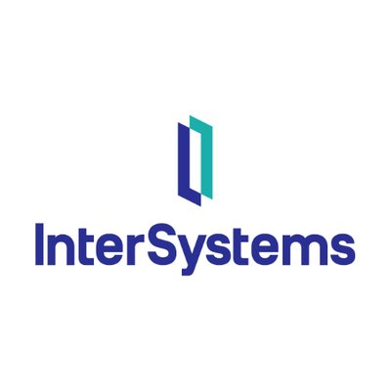





















Technology Stack
Customer Service Software
Database Software
Ada
Amazon SQS
Knowledge Cloud
Sitecore
GraphQL
InterSystems Cache
SQL Developer
Amazon DynamoDB
Data Center Software
Data Management Software
Nlyte
Azure Site Recovery
Commvault Cloud
Flow Software
Google Cloud Storage Transfer Service
Design Software
DevOps Software
Adobe After Effects
Adobe Creative Suite
Adobe Photoshop
Adobe Premiere
Grafana
Nexus Repository Manager
Review Assistant
SonarQube
E-Commerce Software
Education Software
2Captcha
Aria Systems
Downstream
EKM
Assess.ai
Pluralsight
General Assembly
ServiceSkills
Note: The tools listed above are not exhaustive.

Slide 19


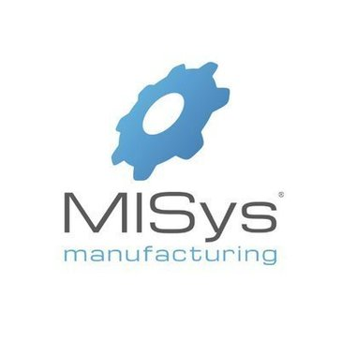

















Technology Stack
Enterprise Resource Planning Software
Finance & Accounting Software
Apache Velocity
Enterprise Architect
MISys
NetSuite
ETran
Fixed Asset Depreciation
hCentive
Oracle Essbase
Financial Services & Insurance Software
Food & Beverage Software
TAMARAC
Computrition
Generative AI Software
Geographic Information System Software
AWS Bedrock
ChatGPT
Develop Diverse
ArcMap
Manifold System
Esri ArcGIS
Maptitude
Governance, Risk & Compliance Software
Grant Management Software
Assurance
RSA Archer
Source Intelligence
Submittable
Note: The tools listed above are not exhaustive.

Slide 20


























Technology Stack
Health Care Software
Hosting Providers
AdvancedMD
Change Healthcare
ChartWare
EHR1
Network Solutions
OVH
Amazon CloudFront
Amazon Route 53
Human Capital Management Software
IT Infrastructure Software
Compensation Tool
HR Director
LinkedIn Recruiter
Media Partners
Amazon EC2
Amazon VPC
Generation Digital
Log4j
IT Management Software
Laboratory Software
AirWatch
Amazon Simple Notification Service (SNS)
Cisco Packet Tracer
IBM InfoSphere Information Analyzer
Orchard Harvest
SciPy
imagej
Covidence
Legal Software
Life Sciences Software
CaseManager
IBM Micromedex
Clindex CDMS/CTMS/EDC
Clinical Conductor CTMS
Veeva eTMF
Note: The tools listed above are not exhaustive.

Slide 21






















Technology Stack
Marketing Software
Networking Hardware
Brandwatch
CB Insights
Cross Sell
Dataminr
Cisco Asa Firewall
FortiGate FortiWiFi 60F
Fortinet Firewalls
Office Administration Software
Oil & Gas Software
Active Directory
Apigee
aruba
Bastion Host VPC
QC Database
Operating Systems Software
Payment Software
Linux
Windows Server
Apple iOS
Ubuntu
PayPal
American Express
Mastercard
Payeezy
Productivity & Collaboration Software
Programming Language
Staffbase
Verizon (ACS)
Webex Webinars
Microsoft Teams
JavaScript
PHP
C#
Hyper Text Markup Language (HTML)
Note: The tools listed above are not exhaustive.

Slide 22




















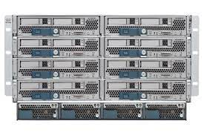





Technology Stack
Project Portfolio Management Software
Real Estate Software
Clarity PPM
Kanban Tool
next project
SWOT
iOFFICE
ProLease
Yardi Voyager
Azure
Retail Software
Robotic Process Automation Software
Symphony AI platform
Celonis
OpenText MBPM
Pega Platform
UiPath RPA
Sales Software
Security Software
Contrato
Oracle CPQ Cloud
Tableau CRM (Formerly Einstein Analytics)
RevOps
Appsulate
Azure Sentinel
Cisco ISE
Cisco Meraki
Servers
Software Development
Cisco UCS
Dell EMC PowerScale/Isilon
Dell PowerEdge C
HP ProLiant
CloudBees
Crashlytics
data.ai Intelligence (formerly App Annie)
Django
Note: The tools listed above are not exhaustive.

Slide 23

Global Footprint:
Finance & Accounting
Global Finance & Accounting Footprint for Hospital Corporation of America
4
Total Number of Locations
512
87
Key Locations
Total Workforce
Greater London, United Kingdom Alexandria, Egypt Tabuk, Saudi Arabia Cape Winelands, Western Cape, South Africa
21,330
Focused Workloads for Top Locations
Americas
~2.4%
~96.5%
APAC
Houston, Texas Area, United States • General Accounting • Financial Planning & Analysis • Accounts Receivable • Accounts Payable • Financial Regulatory Reporting & Compliance Greater Nashville, Tennessee Area, United States • General Accounting • Financial Planning & Analysis • Internal Audit & Reporting • Tax • Accounts Receivable
EMEA
~1.1%
76
20,592
7
226
Key Locations
Key Locations
Greater Nashville, Tennessee Area, United States Houston, Texas Area, United States San Antonio, Texas Area, United States Miami-Fort Lauderdale Area, United States Tampa-St. Petersburg, Florida Area, United States
Central Luzon, Philippines West Java, Indonesia Wellington, New Zealand Vaishali Area, India National Capital Region, India
No. of Locations
Total Workforce
Regional Workforce Proportion
Note: Percentages may not sum to 100%, because of rounding. The above-mentioned focused workloads are not exhaustive.

Slide 24
Global Footprint:
IT
Global IT Footprint for Hospital Corporation of America
1
Total Number of Locations
120
39
Key Locations
Total Workforce
Greater London, United Kingdom
3,500
Focused Workloads for Top Locations
Americas
~3.4%
~96.6%
Dallas-Fort Worth Area, United States • Business Intelligence & Analytics Greater Nashville, Tennessee Area, United States • Business Intelligence & Analytics • Application Development & Maintenance • Infrastructure Management System • Data Engineering • Data Centre Management
EMEA
38
3,380
Key Locations
Greater Nashville, Tennessee Area, United States Dallas-Fort Worth Area, United States Houston, Texas Area, United States Miami-Fort Lauderdale Area, United States Tampa-St. Petersburg, Florida Area, United States
No. of Locations
Total Workforce
Regional Workforce Proportion
Note: Percentages may not sum to 100%, because of rounding. The above-mentioned focused workloads are not exhaustive.

Slide 25
Global Footprint:
Human Resources
Global Human Resources Footprint for Hospital Corporation of America
1
Total Number of Locations
300
96
Key Locations
Total Workforce
Greater London, United Kingdom
37,440
Focused Workloads for Top Locations
Americas
~0.8%
~99.0%
APAC
Miami-Fort Lauderdale Area, United States • Talent Acquisition • Workforce Administration & Management • Hr Strategy & Governance • Learning & Development • Compensation & Benefits Greater Nashville, Tennessee Area, United States • Talent Acquisition • Workforce Administration & Management • Learning & Development • Compensation & Benefits • Hr Strategy & Governance
EMEA
~0.2%
93
37,062
2
78
Key Locations
Key Locations
Greater Nashville, Tennessee Area, United States Miami-Fort Lauderdale Area, United States Tampa-St. Petersburg, Florida Area, United States Houston, Texas Area, United States Dallas-Fort Worth Area, United States
Greater Adelaide Area, Australia Auckland, New Zealand
No. of Locations
Total Workforce
Regional Workforce Proportion
Note: Percentages may not sum to 100%, because of rounding. The above-mentioned focused workloads are not exhaustive.

Slide 26
Global Footprint:
Legal
Global Legal Footprint for Hospital Corporation of America
1
Total Number of Locations
43
36
Key Locations
Total Workforce
Hertfordshire, United Kingdom
4,770
Focused Workloads for Top Locations
Americas
~0.9%
~98.2%
APAC
Greater Nashville, Tennessee Area, United States • Contract Management & Transaction • Legal Support & Paralegal • Litigation • Legal Governance & Compliance Tampa-St. Petersburg, Florida Area, United States • Contract Management & Transaction
EMEA
~0.9%
34
4,682
1
45
Key Locations
Key Locations
Greater Nashville, Tennessee Area, United States Tampa-St. Petersburg, Florida Area, United States Kansas City Metropolitan Area, United States Dallas-Fort Worth Area, United States Greater St. Louis Area, United States
Rajshahi, Bangladesh
No. of Locations
Total Workforce
Regional Workforce Proportion
Note: Percentages may not sum to 100%, because of rounding. The above-mentioned focused workloads are not exhaustive.

Slide 27
Global Footprint:
Sales & Marketing
Global Sales & Marketing Footprint for Hospital Corporation of America
4
Total Number of Locations
1,285
100
Key Locations
Total Workforce
Greater London, United Kingdom Rivers, Nigeria Central, Ghana West Midlands, United Kingdom
34,830
Focused Workloads for Top Locations
Americas
~3.7%
~94.5%
APAC
Houston, Texas Area, United States • Business Development • Sales Strategy & Planning • Marketing Strategy & Brand Management • Communication & Public Relation • Account Management Greater Nashville, Tennessee Area, United States • Marketing Strategy & Brand Management • Sales Strategy & Planning • Communication & Public Relation • Sales Enablement & Support • Business Development
EMEA
~1.8%
88
32,919
8
626
Key Locations
Key Locations
Greater Nashville, Tennessee Area, United States Houston, Texas Area, United States Miami-Fort Lauderdale Area, United States Dallas-Fort Worth Area, United States San Antonio, Texas Area, United States
Greater Melbourne Area, Australia Ahmedabad Area, India Tehran, Iran Jakarta, Indonesia Ernakulam Area, India
No. of Locations
Total Workforce
Regional Workforce Proportion
Note: Percentages may not sum to 100%, because of rounding. The above-mentioned focused workloads are not exhaustive.

Slide 28
Global Footprint:
Customer Support & Service
Global Customer Support & Service Footprint for Hospital Corporation of America
4
Total Number of Locations
1,079
80
Key Locations
Total Workforce
Cheshire, United Kingdom Greater London, United Kingdom Federal Capital Territory, Nigeria Conwy, United Kingdom
24,620
Focused Workloads for Top Locations
Americas
~4.4%
~95.3%
APAC
Houston, Texas Area, United States • Customer Service & Support • Product Installation, Maintenance & Technical Support • Customer Success Greater Nashville, Tennessee Area, United States • Product Installation, Maintenance & Technical Support • Customer Service & Support • Customer Success
EMEA
~0.4%
74
23,451
2
90
Key Locations
Key Locations
Greater Nashville, Tennessee Area, United States Houston, Texas Area, United States Miami-Fort Lauderdale Area, United States Dallas-Fort Worth Area, United States San Antonio, Texas Area, United States
Greater Melbourne Area, Australia Madurai Area, India
No. of Locations
Total Workforce
Regional Workforce Proportion
Note: Percentages may not sum to 100%, because of rounding. The above-mentioned focused workloads are not exhaustive.

Slide 29
Global Footprint:
Procurement
Global Procurement Footprint for Hospital Corporation of America
1
Total Number of Locations
237
21
Key Locations
Total Workforce
Greater London, United Kingdom
2,750
Focused Workloads for Top Locations
Americas
~8.6%
~91.4%
Dallas-Fort Worth Area, United States • Strategic Sourcing & Purchasing Greater Nashville, Tennessee Area, United States • Strategic Sourcing & Purchasing • Vendor Management
EMEA
20
2,513
Key Locations
Greater Nashville, Tennessee Area, United States Dallas-Fort Worth Area, United States Asheville, North Carolina Area, United States Richmond, Virginia Area, United States Houston, Texas Area, United States
No. of Locations
Total Workforce
Regional Workforce Proportion
Note: Percentages may not sum to 100%, because of rounding. The above-mentioned focused workloads are not exhaustive.

Slide 30
Global Footprint:
Supply Chain
Global Supply Chain Footprint for Hospital Corporation of America
1
Total Number of Locations
89
44
Key Locations
Total Workforce
Greater London, United Kingdom
10,530
Focused Workloads for Top Locations
Americas
~0.8%
~99.2%
Greater Denver Area, United States • Logistics & Distribution • Warehousing • Inventory Management • Fulfilment Management Greater Nashville, Tennessee Area, United States • Supply Chain Analytics • Logistics & Distribution • Warehousing • Inventory Management • Fulfilment Management
EMEA
43
10,441
Key Locations
Greater Nashville, Tennessee Area, United States Greater Denver Area, United States Miami-Fort Lauderdale Area, United States Houston, Texas Area, United States Richmond, Virginia Area, United States
No. of Locations
Total Workforce
Regional Workforce Proportion
Note: Percentages may not sum to 100%, because of rounding. The above-mentioned focused workloads are not exhaustive.

Slide 31
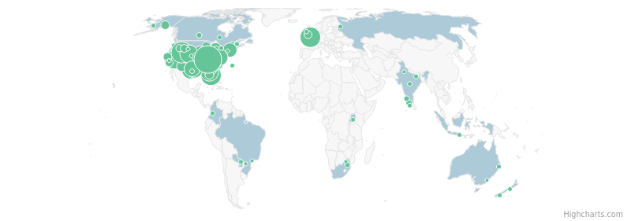
Hiring Analysis – Overall
39554
Job Postings (in last 12 Months)
183
Locations with Job Postings (in last 12 Months)
Top Locations | # of Job Postings
Greater Nashville, Tennessee Area, United States | 5420
Greater Salt Lake City Area, United States | 2737
Greater London, United Kingdom | 2614
Miami-Fort Lauderdale Area, United States | 2488
Dallas-Fort Worth Area, United States | 2298
Las Vegas, Nevada Area, United States | 2154
Tampa-St. Petersburg, Florida Area, United States | 1869
Greater Denver Area, United States | 1836
Kansas City Metropolitan Area, United States | 1771
San Antonio, Texas Area, United States | 1633
Job Postings Timeline
HIGH
MEDIUM
LOW
Recent Executive Movements
Top Business Functions
Top Workloads
Liz Mac, MSN, RN, NEA-BC, FACHE Quit as Nursing Director, Hospital Corporation of America Aug. 2025
Lukas Mallasch MBA, BSN, RN, CCRN, VA-BC Quit as Clinical Nurse Coordinator For Vascular Access Team, Hospital Corporation of America Jul. 2025
Art Salazar MBA, RCIS, RCS, RCES Joined as Director of Cath Lab/EP Lab, Hospital Corporation of America Jun. 2025
Healthcare Operations IT Sales & Marketing Supply Chain Management & Strategy
Nursing Hospital Admin & Support Services Business Intelligence & Analytics Physicians & Surgeons Laboratory
Associate Chief Nursing Officer, Williamson Health
Colorado Regional Director Of Nursing, Sandstone Care
Adjunct Faculty Instructor, St. Philip's College
Get more insights
Note: The insights as mentioned above are based on job postings data for the last 12 months and are not exhaustive

Slide 32
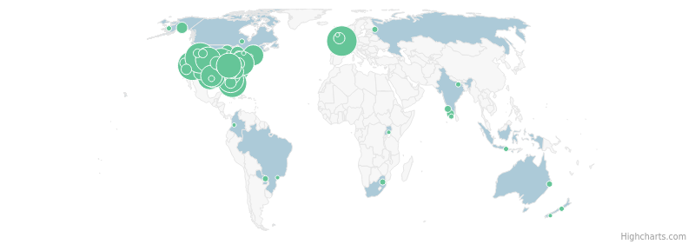
Hiring Analysis – Healthcare Operations
17079
Job Postings (in last 12 Months)
135
Locations with Job Postings (in last 12 Months)
Top Locations | # of Job Postings
Greater Salt Lake City Area, United States | 1338
Greater London, United Kingdom | 1254
Las Vegas, Nevada Area, United States | 1183
Miami-Fort Lauderdale Area, United States | 1165
Dallas-Fort Worth Area, United States | 994
Tampa-St. Petersburg, Florida Area, United States | 857
Greater Nashville, Tennessee Area, United States | 847
Greater Denver Area, United States | 843
Kansas City Metropolitan Area, United States | 826
San Antonio, Texas Area, United States | 735
Job Postings Timeline
HIGH
MEDIUM
LOW
Recent Executive Movements
Top Workloads
Job Titles in Demand
Core Skills in Demand
Trina Kaylor Promoted as Vice President Supply Chain Transformation, Hospital Corporation of America Jan. 2025
Ajit Singh Promoted as Division Chief Medical Officer, Hospital Corporation of America Oct. 2024
Nursing Hospital Admin & Support Services Physicians & Surgeons Therapeutic Laboratory
Medical Assistant Medical Office Specialist Registered Nurse Medical Records Specialist Medical Technologist
Patient Care Patient Centered Care Nursing Care Clinical Expertise Diagnostic Tools
Senior Vice President Supply Chain Operations, Hospital Corporation of America
Chief Medical Officer, Hospital Corporation of America
Get more insights
Note: The insights as mentioned above are based on job postings data for the last 12 months and are not exhaustive

Slide 33
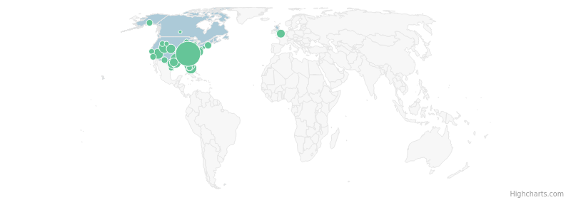
Hiring Analysis – IT
3282
Job Postings (in last 12 Months)
73
Locations with Job Postings (in last 12 Months)
Top Locations | # of Job Postings
Greater Nashville, Tennessee Area, United States | 1309
Greater Salt Lake City Area, United States | 170
Miami-Fort Lauderdale Area, United States | 147
Tampa-St. Petersburg, Florida Area, United States | 144
Dallas-Fort Worth Area, United States | 139
Las Vegas, Nevada Area, United States | 128
Kansas City Metropolitan Area, United States | 114
Houston, Texas Area, United States | 105
San Antonio, Texas Area, United States | 102
Greater Denver Area, United States | 92
Job Postings Timeline
HIGH
MEDIUM
LOW
Recent Executive Movements
Top Workloads
Job Titles in Demand
Core Skills in Demand
Laura Cook Promoted as Senior Director, Hospital Corporation of America Jun. 2025
Ryan Curry Promoted as Sr. Director, Analytics and Reporting, Hospital Corporation of America Apr. 2025
Business Intelligence & Analytics Hospital Admin & Support Services Application Development & Maintenance Data Engineering Data Centre Management
Clinical Resource Director Medical Business Office Specialist Business Office Specialist Director Emergency Services Director Case Management
Structured Query Language (SQL) Python (Programming Language) Patient Care Project Management Strategic Planning
Data Consultant, Clinical Excellence, Hospital Corporation of America
Director of Data Science, Hospital Corporation of America
Get more insights
Note: The insights as mentioned above are based on job postings data for the last 12 months and are not exhaustive

Slide 34
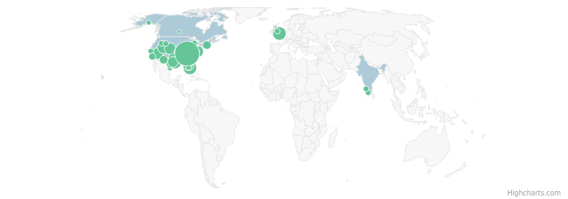
Hiring Analysis – Sales & Marketing
1382
Job Postings (in last 12 Months)
75
Locations with Job Postings (in last 12 Months)
Top Locations | # of Job Postings
Greater Nashville, Tennessee Area, United States | 416
Greater London, United Kingdom | 89
Dallas-Fort Worth Area, United States | 88
Miami-Fort Lauderdale Area, United States | 87
Greater Salt Lake City Area, United States | 73
Houston, Texas Area, United States | 66
Tampa-St. Petersburg, Florida Area, United States | 56
Richmond, Virginia Area, United States | 56
Las Vegas, Nevada Area, United States | 54
Greater Denver Area, United States | 54
Job Postings Timeline
HIGH
MEDIUM
LOW
Recent Executive Movements
Top Workloads
Job Titles in Demand
Core Skills in Demand
Andrew Henderson Promoted as AVP Media Performance, Hospital Corporation of America Nov. 2024
Sales Enablement & Support Marketing Strategy & Brand Management Sales Strategy & Planning Business Intelligence & Analytics Product Management
X-Ray Tech - Medical Assistant Technical Analyst Technical Analyst Ii Patient Account Collections Specialist Home Health Account Sales Representative
Microsoft Office Business Development Patient Care Customer Support Service Desk Management
Director Marketing Strategy, Hospital Corporation of America
Get more insights
Note: The insights as mentioned above are based on job postings data for the last 12 months and are not exhaustive

Slide 35
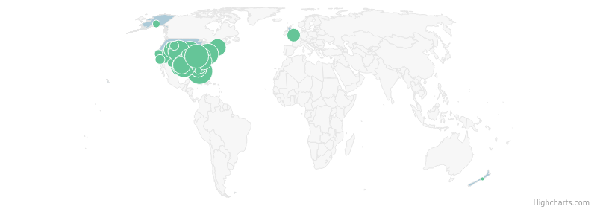
Hiring Analysis – Supply Chain
1049
Job Postings (in last 12 Months)
59
Locations with Job Postings (in last 12 Months)
Top Locations | # of Job Postings
Miami-Fort Lauderdale Area, United States | 100
Greater Nashville, Tennessee Area, United States | 76
Houston, Texas Area, United States | 73
Dallas-Fort Worth Area, United States | 66
Richmond, Virginia Area, United States | 64
Greater Denver Area, United States | 64
Kansas City Metropolitan Area, United States | 63
San Antonio, Texas Area, United States | 49
Asheville, North Carolina Area, United States | 45
Tampa-St. Petersburg, Florida Area, United States | 40
Job Postings Timeline
HIGH
MEDIUM
LOW
Recent Executive Movements
Top Workloads
Job Titles in Demand
Core Skills in Demand
Paul Cox Promoted as Assistant Vice President, Supply Chain Software Development, Hospital Corporation of America Apr. 2025
Dean Cropper Promoted as Director Of Supply Chain Operations, Hospital Corporation of America Oct. 2024
Inventory Management Logistics & Distribution Warehousing Supply Chain Analytics Business Intelligence & Analytics
Supply Chain Technician Or Supply Chain Technician Equipment Inventory Technician Supply Chain Tech Warehouse Material Handler
Inventory Management Supply Chain Management (SCM) Warehousing Supply Chain Operations Stocking
Director Of Supply Chain Product Development, Healthtrust, Hospital Corporation of America
Market Director, Hospital Corporation of America
Get more insights
Note: The insights as mentioned above are based on job postings data for the last 12 months and are not exhaustive

Slide 36

Hiring Analysis – Management & Strategy
824
Job Postings (in last 12 Months)
59
Locations with Job Postings (in last 12 Months)
Top Locations | # of Job Postings
Greater Nashville, Tennessee Area, United States | 351
Miami-Fort Lauderdale Area, United States | 48
Greater London, United Kingdom | 45
Las Vegas, Nevada Area, United States | 30
Greater Salt Lake City Area, United States | 30
Tallahassee, Florida Area, United States | 28
Dallas-Fort Worth Area, United States | 27
Houston, Texas Area, United States | 26
Tampa-St. Petersburg, Florida Area, United States | 23
Kansas City Metropolitan Area, United States | 23
Job Postings Timeline
HIGH
MEDIUM
LOW
Top Workloads
Job Titles in Demand
Core Skills in Demand
Corporate Strategy & Management Consulting Project/Programs Management Governance, Risk & Compliance Product Management Leadership & Governance
Vice President Operations Senior Project Manager I Program Manager Senior Project Manager Project Manager Ii
Project Management Microsoft Office Risk Management Educational Accreditation Performance Improvement
Get more insights
Note: The insights as mentioned above are based on job postings data for the last 12 months and are not exhaustive

Slide 37
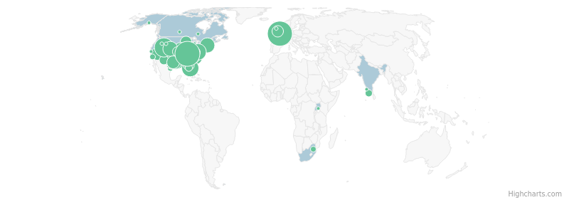
Hiring Analysis – Administrative Operations
823
Job Postings (in last 12 Months)
71
Locations with Job Postings (in last 12 Months)
Top Locations | # of Job Postings
Greater London, United Kingdom | 111
Greater Nashville, Tennessee Area, United States | 109
Dallas-Fort Worth Area, United States | 73
Greater Salt Lake City Area, United States | 56
Miami-Fort Lauderdale Area, United States | 43
Richmond, Virginia Area, United States | 38
Kansas City Metropolitan Area, United States | 32
Greater Denver Area, United States | 32
Greater Boston Area, United States | 31
Greater Myrtle Beach Area, United States | 25
Job Postings Timeline
HIGH
MEDIUM
LOW
Top Workloads
Job Titles in Demand
Core Skills in Demand
Admin & Support Environment, Health & Safety Asset Maintenance & Engineering Security & Surveillance/Asset Protection Corporate Strategy & Management Consulting
Medical Office Coordinator Housekeeping Assistant Front Desk Coordinator Administrative Assistant Executive Assistant
Microsoft Office Patient Care Administrative Assistance Housekeeping Plumbing
Get more insights
Note: The insights as mentioned above are based on job postings data for the last 12 months and are not exhaustive

Slide 38

Hiring Analysis – Human Resources
733
Job Postings (in last 12 Months)
55
Locations with Job Postings (in last 12 Months)
Top Locations | # of Job Postings
Greater Nashville, Tennessee Area, United States | 238
Miami-Fort Lauderdale Area, United States | 58
Tampa-St. Petersburg, Florida Area, United States | 57
Asheville, North Carolina Area, United States | 49
Houston, Texas Area, United States | 32
Greater London, United Kingdom | 30
Dallas-Fort Worth Area, United States | 29
Las Vegas, Nevada Area, United States | 27
Greater Salt Lake City Area, United States | 25
Kansas City Metropolitan Area, United States | 19
Job Postings Timeline
HIGH
MEDIUM
LOW
Recent Executive Movements
Top Workloads
Job Titles in Demand
Core Skills in Demand
Mark Garrett Promoted as Vice President Human Resources, Hospital Corporation of America Nov. 2024
Workforce Administration & Management Talent Acquisition Learning & Development HR Strategy & Governance Business Intelligence & Analytics
Human Resources Business Partner Human Resources Coordinator Vice President Of Human Resources Associate Recruiter Compensation Consultant
Employee Relations Management Patient Care Project Management Program Implementation Performance Management
Vice President Human Resources, Hospital Corporation of America
Get more insights
Note: The insights as mentioned above are based on job postings data for the last 12 months and are not exhaustive

Slide 39
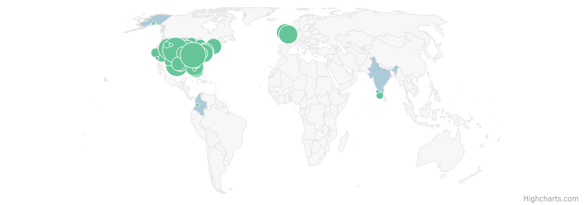
Hiring Analysis – Customer Support & Service
708
Job Postings (in last 12 Months)
71
Locations with Job Postings (in last 12 Months)
Top Locations | # of Job Postings
Greater Nashville, Tennessee Area, United States | 75
Greater Denver Area, United States | 72
San Antonio, Texas Area, United States | 56
Kansas City Metropolitan Area, United States | 51
Greater Salt Lake City Area, United States | 46
Dallas-Fort Worth Area, United States | 46
Greater London, United Kingdom | 34
Richmond, Virginia Area, United States | 33
Tampa-St. Petersburg, Florida Area, United States | 31
Denbighshire, United Kingdom | 30
Job Postings Timeline
HIGH
MEDIUM
LOW
Top Workloads
Job Titles in Demand
Core Skills in Demand
Customer Service & Support Product Installation, Maintenance & Technical Support Asset Maintenance & Engineering Property Management Admin & Support
Customer Service Registrar Customer Service Coordinator Facility Supply Chain Technician Contact Centre Advisor Patient Customer Advisor
Microsoft Office Health Information Management (HIM) Revenue Cycle Management Case Management Payment Methodology
Get more insights
Note: The insights as mentioned above are based on job postings data for the last 12 months and are not exhaustive

Slide 40
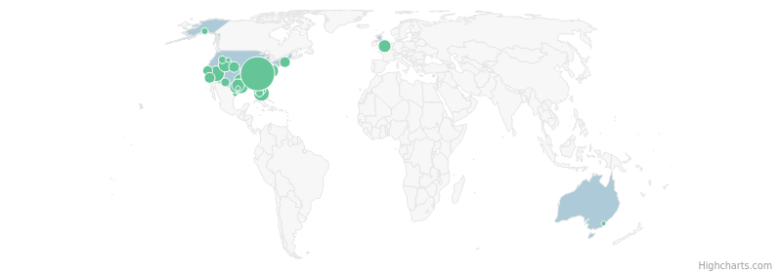
Hiring Analysis – Finance & Accounting
591
Job Postings (in last 12 Months)
56
Locations with Job Postings (in last 12 Months)
Top Locations | # of Job Postings
Greater Nashville, Tennessee Area, United States | 270
Miami-Fort Lauderdale Area, United States | 34
Las Vegas, Nevada Area, United States | 33
Houston, Texas Area, United States | 26
Dallas-Fort Worth Area, United States | 23
Greater Salt Lake City Area, United States | 21
San Antonio, Texas Area, United States | 19
Richmond, Virginia Area, United States | 19
Tampa-St. Petersburg, Florida Area, United States | 17
Austin, Texas Area, United States | 17
Job Postings Timeline
HIGH
MEDIUM
LOW
Recent Executive Movements
Top Workloads
Job Titles in Demand
Core Skills in Demand
Jordan Turbeville Promoted as Vice President Of Operations Support & Analytics, Hospital Corporation of America Feb. 2025
Whitney Bendel Promoted as Chief Financial Officer, Hospital Corporation of America Sep. 2024
Financial Planning & Analysis General Accounting Accounts Receivable Business Intelligence & Analytics Hospital Admin & Support Services
Assistant Chief Financial Officer Financial Analyst Chief Financial Officer Accountant Senior Accountant
Balance Sheet Analysis Accounts Receivable (AR) Financial Reporting Medicaid Financial Analysis
Assistant Vice President Of Financial Analytics, Hospital Corporation of America
Chief Financial Officer, Hospital Corporation of America
Get more insights
Note: The insights as mentioned above are based on job postings data for the last 12 months and are not exhaustive

Slide 41
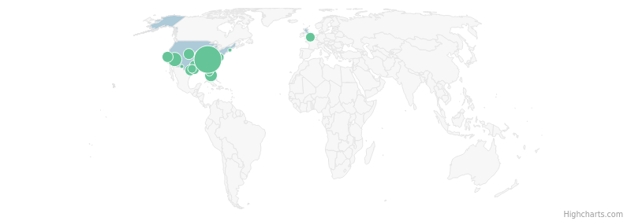
Hiring Analysis – Legal
176
Job Postings (in last 12 Months)
31
Locations with Job Postings (in last 12 Months)
Top Locations | # of Job Postings
Greater Nashville, Tennessee Area, United States | 82
Las Vegas, Nevada Area, United States | 14
Miami-Fort Lauderdale Area, United States | 11
Kansas City Metropolitan Area, United States | 9
San Antonio, Texas Area, United States | 8
Greater Denver Area, United States | 8
San Francisco Bay Area, United States | 7
Houston, Texas Area, United States | 5
Greater London, United Kingdom | 5
Dallas-Fort Worth Area, United States | 5
Job Postings Timeline
HIGH
MEDIUM
LOW
Top Workloads
Job Titles in Demand
Core Skills in Demand
Legal Support & Paralegal Contract Management & Transaction Business Intelligence & Analytics Hospital Admin & Support Services IT Risk Management
Performance Improvement Manager Labor Inpatient Coding Resolution Specialist Manager Labor Performance Improvement Paralegal Contract Analyst
Management Reporting Budgeting Microsoft Office Requisition Processing Performance Improvement
Get more insights
Note: The insights as mentioned above are based on job postings data for the last 12 months and are not exhaustive

Slide 42
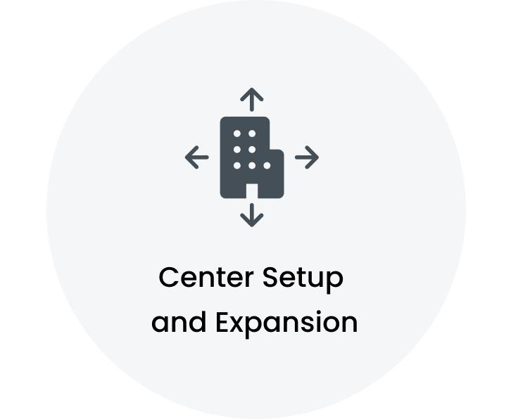
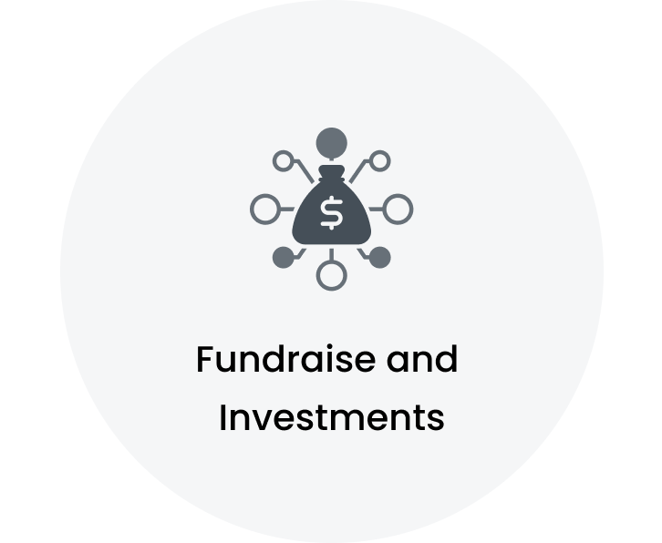

Key Signals
HCA planning $260M Magnolia Hospital near Hull Street and Otterdale roads in Chesterfield HCA Florida Twin Cities Hospital breaks ground on $19 million freestanding ER in DeFuniak Springs HCA Healthcare permitted to build Arlington free-standing emergency department
HCA and City of Hamilton Secure $789,580 for Flood and Erosion Wetland Restoration Project HCA Florida Ocala Hospital staff raise $1,000 for Ronald McDonald House in Gainesville HCA Healthcare Announces HCA Healthcare Foundations $1 Million Grant to Enhance Work With Educate Texas
HCA Seeks Vendors For State Employee Dental And Vision Benefits, Proposal Deadline Aug. 18 RNs at HCAs Good Samaritan Hospital ratify new contract with strong measures to improve patient safety and nurse retention HCA Healthcare and Feel Good launch 12-month programme of wellbeing workshops Anthem BCBS and HCA Healthcare agree to contract extension as they work to finalize deal
Note: The signals mentioned above are not exhaustive.

Slide 43
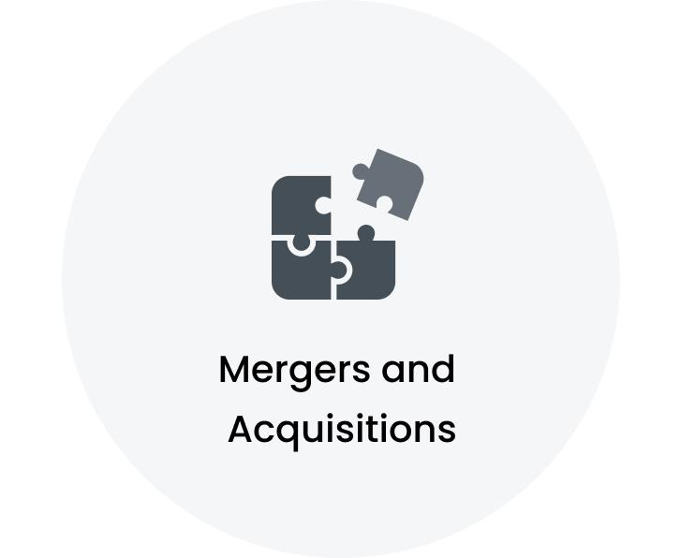
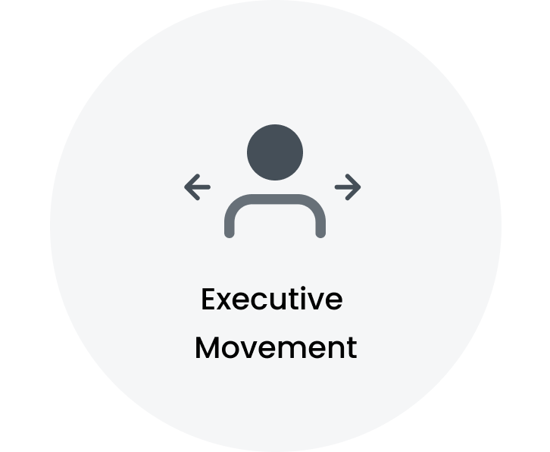
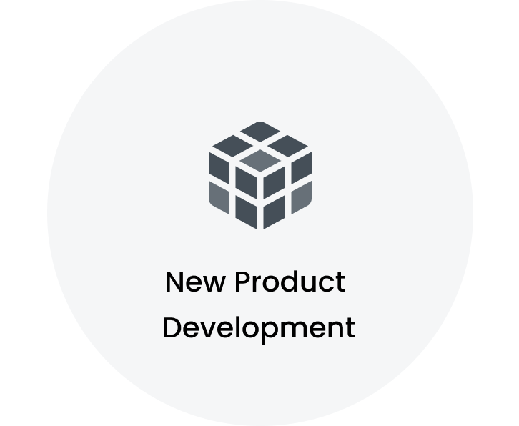
Key Signals
HCAs takeover of CMC has changed the health care landscape CMC joins HCA Healthcare family as of Feb. 1 Santa Clara County to acquire Regional Medical Center from HCA Healthcare for $150 million Attorney General approves Catholic Medical Center partnership with HCA Healthcare
HCA Healthcare (HCA) Expands Board with New Appointment HCA Healthcare's Strategic Board Move: A Play for Operational Precision and Governance Leadership HCA Healthcare Appoints John Chidsey to Board Joseph Everette named Chief Nursing Officer at HCA Fort Walton-Destin Hospital where he was born
HCA Florida Gulf Coast Hospital unveils new robotic spine surgery technology
Note: The signals mentioned above are not exhaustive.

Slide 44


Outsourcing Overview: Application Development & Maintenance is the highly outsourced segment
Active Outsourcing Partners
~
62
Total Workforce analyzed
~
1124
Highlights
Workflows split by Micro verticals
Key Service Providers are Atos | TCS | Nesco Resource Top Outsourced Workloads are Application Development & Maintenance | Data Engineering | Business Intelligence & Analytics Top Service Partner Locations are Hyderabad Area, India | Bengaluru Area, India | Pune Area, India

Slide 45

Vendor Analysis: A Comprehensive List of Top 15 Companies
Atos, TCS, Wipro are the key service providers for Hospital Corporation of America
Top 15 service providers cover 55% of the total outsourcing workflows
Key Provider Locations:
Hyderabad Area, India Bengaluru Area, India Pune Area, India Chennai Area, India Greater Nashville, Tennessee Area, United States

Slide 46




Top 5 Service Providers:
Atos is the key strategic partner for Hospital Corporation of America
Key Provider | Key Provider MSA | Workflows split by Micro Vertical
Pune Area, India Chennai Area, India Greater Nashville, Tennessee Area, United States
Bengaluru Area, India Hyderabad Area, India Chennai Area, India
Nesco Resource
Greater Nashville, Tennessee Area, United States
Bengaluru Area, India Hyderabad Area, India National Capital Region, India
Bengaluru Area, India Hyderabad Area, India

Slide 47



Functional Workload Deep Dive (1/20): Application Development & Maintenance
Total Outsourcing Partners
Total Workflows Analyzed
Service Providers | Key Workflow
 | • Business requirements involvement • Module requirements finalization with SME • Business requirement review and detail design document preparation
 | • Primary designer of systems architecture for Medicare and Medicaid products • Understanding customer requirements for new changes • Preparing technical specification documents
 | • Analysis of business requirements into functional application features • Diagnosis and resolution of bugs during testing • Development of front-end components with Blazor and back-end services...
 | • Implementation of code modifications in Java • Development of analysis and debugging processes for Java code changes • Utilization of Spring Boot for application development
 | • Mainframe application development and modernization • Maintenance and enhancement of mission-critical mainframe applications • Management of billing, patient information, insurance claims proc...
~ 17
~ 21
Share by Service Providers
Key Provider Locations
Hyderabad Area, India
Bengaluru Area, India
Pune Area, India
Chennai Area, India
Thiruvananthapuram Area, India
Note: Service Provider share is based on the number of projects.

Slide 48




Functional Workload Deep Dive (2/20): Data Engineering
Total Outsourcing Partners
Total Workflows Analyzed
Service Providers | Key Workflow
 | • Google Cloud Certified Professional Data Engineer certification • Requirement gathering and analysis • Regular client interaction for requirement gathering and status updates
 | • Project management • Coordination of research activities • Oversight of clinical trials
 | • Business process analysis and requirement understanding • Requirement discussions and solution evaluations with BAs • ETL mapping design and modification using Informatica
 | • Analysis of business processes and requirements • Collaboration with business analysts on requirements and solutions • Design of new ETL mappings using Informatica
 | • Advanced data engineering techniques for healthcare datasets integration and analysis • Azure Data Factory and Apache Spark for data pipeline design and optimization • Collaboration with cross...
~ 10
~ 15
Share by Service Providers
Key Provider Locations
Pune Area, India
Hyderabad Area, India
Bengaluru Area, India
Greater Nashville, Tennessee Area, United States
Chennai Area, India
Note: Service Provider share is based on the number of projects.

Slide 49



Functional Workload Deep Dive (3/20): Business Intelligence & Analytics
Total Outsourcing Partners
Total Workflows Analyzed
Service Providers | Key Workflow
 | • Project Objective: HCA Healthcare services improvement • QMIRS application for generating hospital reports • Data received from upstream applications
 | • Gathering requirements from business users and analyzing them • Importing data from sources and preparing it according to requirements • Identifying key performance metrics and reporting metri...
 | • Requirement analysis and system understanding • Data source analysis including SQL server and flat files • Data modifications for improved modeling and visualization
Aithent Technologies Private Limited | • Data analysis of extensive patient data for insights and trends • Development of user-friendly dashboards and business intelligence reports in Power BI • Collaboration with healthcare professi...
 | • Business Analyst role • Business Analysis, Roadmap planning, and Release Management responsibilities • Backlog refinement for E-Accessibility compliance
~ 12
~ 15
Share by Service Providers
Key Provider Locations
Bengaluru Area, India
Hyderabad Area, India
Chennai Area, India
Greater Nashville, Tennessee Area, United States
Pune Area, India
Note: Service Provider share is based on the number of projects.

Slide 50


Functional Workload Deep Dive (4/20): Project/Programs Management
Total Outsourcing Partners
Total Workflows Analyzed
Service Providers | Key Workflow
Nesco Resource | • Project plans development • Task completion monitoring • Deliverable status communication
 | • Scrum Master responsibilities • Review of backlog items and sprint planning • Preparation of dashboards in ADO
 | • Overall management and continuous improvement of program deliverables • Partnership with Account and Customer Experience leaders • Development and execution of visionary and strategic improvem...
Geonamic Systems | • Team leadership for GIS tasks • Utilization of Genomic and Esri software platforms • Alignment and loading of inspection data
 | • Project management • Development of strategic plans • Coordination of cross-functional teams
~ 8
~ 13
Share by Service Providers
Key Provider Locations
Greater Nashville, Tennessee Area, United States
Pune Area, India
Houston, Texas Area, United States
Hyderabad Area, India
National Capital Region, India
Note: Service Provider share is based on the number of projects.

Slide 51



Functional Workload Deep Dive (5/20): Infrastructure Management System
Total Outsourcing Partners
Total Workflows Analyzed
Service Providers | Key Workflow
 | • Creation of tablespaces based on application requirements • Creation of objects and indexes as requested by development teams • Involvement in UTS conversion for production and non-production ...
 | • Installation and configuration of MS SQL Server versions and application of service packs and hotfixes • Upgrading and migrating SQL Server instances and databases • Implementation of high ava...
 | • Log extraction and troubleshooting • Batch monitoring and failure analysis • PRB ticketing assistance
 | • Installation and configuration of MS SQL Server versions • Application of service packs and cumulative updates • Database health checks including error log monitoring and job failures
 | • Batch support for 24/7 operations involving ABEND fixes and monitoring batch cycles • Monitoring and ensuring proper batch flow and handling adhoc job scheduling • Managing hold and long-runni...
~ 6
~ 9
Share by Service Providers
Key Provider Locations
Bengaluru Area, India
Pune Area, India
Chennai Area, India
Hyderabad Area, India
Kochi, Japan
Note: Service Provider share is based on the number of projects.

Slide 52


Functional Workload Deep Dive (6/20): Software Testing
Total Outsourcing Partners
Total Workflows Analyzed
Service Providers | Key Workflow
 | • Agile call attendance for individual progress and defect status sharing • Regression testing execution and artifact creation • Unit testing activities including test case and data preparation,...
CL Infotech Private Limited | • AGILE environment participation in scrum and sprint meetings • Development of test plans, scenarios, scripts, and cases based on requirements • Design, development, and maintenance of automate...
 | • Smoke, sanity, and regression suite execution for sprint releases • Automation defect reporting in Jira and defect follow-ups with development team • Analysis of changes in new builds and upda...
 | • Platform development for hospitals and imaging centers • Service request management and technician bidding system • Streamlined service requests and technician selection processes
IRIS Digital | • Preparation of Test Matrix for tracking requirements and test cases • Development and execution of automation test scripts leveraging black and white box testing across functional, non-functi...
~ 9
~ 9
Share by Service Providers
Key Provider Locations
Hyderabad Area, India
Bengaluru Area, India
Chennai Area, India
Jaipur Area, India
Note: Service Provider share is based on the number of projects.

Slide 53

Functional Workload Deep Dive (7/20): System Integration
Total Outsourcing Partners
Total Workflows Analyzed
Service Providers | Key Workflow
 | • Lightning components and apps for improved user interfaces • Apex classes, Visualforce pages, and Apex Triggers for functionality • Custom report types and dashboards for data analysis
 | • Consultant Oracle-Fusion HCM • Requirement stage involvement for design phase understanding • HCM Enterprise and workforce structure configuration
 | • MyHealthONE Application • Simplification of patient and caregiver experience • Quick appointment booking with local doctors
 | • Solution design for BizTalk solutions facilitating data exchange and integration within healthcare systems • Creation and management of healthcare integration maps, schemas, and pipelines ens...
~ 4
~ 4
Share by Service Providers
Key Provider Locations
Bengaluru Area, India
Hyderabad Area, India
National Capital Region, India
Note: Service Provider share is based on the number of projects.

Slide 54


Functional Workload Deep Dive (8/20): Talent Acquisition
Total Outsourcing Partners
Total Workflows Analyzed
Service Providers | Key Workflow
 | • Recruitment efforts for healthcare positions ensuring alignment with client needs and industry standards • Strategic recruitment plans to attract high-quality candidates and meet staffing goa...
Emonics Technologies Private Limited | • Sourcing qualified healthcare candidates through various platforms • Creating job descriptions and graphics for social media engagement • Employing marketing strategies for candidate pool deve...
ICONMA, L.L.C | • Healthcare clients • Recruiting for various roles including RN Med Surg, Dialysis RN, Dialysis Technician, LPN, Pharmacist, and Surgical Tech • Leading team of managers to support recruiting e...
 | • Understanding client requirements • Sourcing candidates from job portals • Finding candidates through referrals and social networking
~ 4
~ 4
Share by Service Providers
Key Provider Location
National Capital Region, India
Note: Service Provider share is based on the number of projects.

Slide 55



Functional Workload Deep Dive (9/20): Account Management
Total Outsourcing Partners
Total Workflows Analyzed
Service Providers | Key Workflow
 | • Account/Territory Management for over 75 clients across various industries • Team leadership of 4-5 night managers • Preparation and negotiation of maintenance project agreements
 | • Administration and support of client benefits • All aspects of benefit setup and annual open enrollment • Reporting and client-facing responsibilities
 | • Overseeing relationships with client portfolio • Maintaining high retention rate • Developing long-term relationships with new clients
~ 3
~ 3
Share by Service Providers
Key Provider Locations
Greater New York City Area, United States
Greater St. Louis Area, United States
San Antonio, Texas Area, United States
Note: Service Provider share is based on the number of projects.

Slide 56

Functional Workload Deep Dive (10/20): Product Installation, Maintenance & Technical Support
Total Outsourcing Partners
Total Workflows Analyzed
Service Providers | Key Workflow
 | • Daily scrum discussions and analysis with customers and business analysts regarding ongoing requirements and feature development • Understanding and designing new features for existing patien...
 | • Monitoring various automation bots • Oversight of claim file monitoring for Billing Bot • Resolution of discrepancies through log analysis
 | • Production Support Engineer • Round-the-clock L1/L2 level production assistance • Expertise in incident problem change and event management
~ 3
~ 3
Share by Service Providers
Key Provider Locations
Chennai Area, India
Greater Nashville, Tennessee Area, United States
Note: Service Provider share is based on the number of projects.

Slide 57

Functional Workload Deep Dive (11/20): Artificial Intelligence & Data Science
Total Outsourcing Partners
Total Workflows Analyzed
Service Providers | Key Workflow
 | • Development of ML Vertex AI pipeline for label generation using NLP (Scispacy - NER+Negation) and LLMs (Palm, MedPalm, and Gemini) • Prioritized patients based on severity and implemented eXp...
~ 1
~ 2
Share by Service Providers
Key Provider Location
Bengaluru Area, India
Note: Service Provider share is based on the number of projects.

Slide 58
Functional Workload Deep Dive (12/20): DevOps
Total Outsourcing Partners
Total Workflows Analyzed
Service Providers | Key Workflow
Exhale Tech Systems | • Good experience with version control tools • Administrating source code management processes • Creating branches, tags, and handling merge conflicts
ICONIC E-TECH | • CI/CD pipeline creation • Integration of Git, GitHub, Maven, Jenkins, Nexus, and AWS • Continuous deployment pipeline establishment
~ 2
~ 2
Share by Service Providers
Key Provider Location
Chennai Area, India
Note: Service Provider share is based on the number of projects.

Slide 59
Functional Workload Deep Dive (13/20): General Accounting
Total Outsourcing Partners
Total Workflows Analyzed
Service Providers | Key Workflow
Auxis, LLC | • Weekly balance management • Medical insurance provision verification • Daily counter closing verification
 | • Support for General Ledger and Accounts Payable Accounts Receivable Modules • Handling tickets and resolving issues on a daily basis • Undertaking necessary steps for satisfactory closure of c...
~ 2
~ 2
Share by Service Providers
Key Provider Locations
Heredia, Costa Rica
Hyderabad Area, India
Note: Service Provider share is based on the number of projects.

Slide 60
Functional Workload Deep Dive (14/20): Accounts Payable
Total Outsourcing Partners
Total Workflows Analyzed
Service Providers | Key Workflow
Auxis, LLC | • Financial team responsibilities • Reconciliation of clearing accounts for various hospitals • Daily reconciliation of multiple clearing accounts
~ 1
~ 1
Share by Service Providers
Key Provider Location
Heredia, Costa Rica
Note: Service Provider share is based on the number of projects.

Slide 61
Functional Workload Deep Dive (15/20): Accounts Receivable
Total Outsourcing Partners
Total Workflows Analyzed
Service Providers | Key Workflow
 | • Project Parallon • Review of denied EOBs and understanding of denials • Outbound calls with payer representatives for claim reprocessing
~ 1
~ 1
Share by Service Providers
Key Provider Location
Chennai Area, India
Note: Service Provider share is based on the number of projects.

Slide 62
Functional Workload Deep Dive (16/20): Cloud Computing
Total Outsourcing Partners
Total Workflows Analyzed
Service Providers | Key Workflow
 | • Conversion of Data stage jobs models into BigQuery compatible queries • Creation of procedures in BigQuery • Writing Dags in Python for Airflow composer to connect with BigQuery
~ 1
~ 1
Share by Service Providers
Key Provider Location
Hyderabad Area, India
Note: Service Provider share is based on the number of projects.

Slide 63

Functional Workload Deep Dive (17/20): Cybersecurity
Total Outsourcing Partners
Total Workflows Analyzed
Service Providers | Key Workflow
 | • Responsible for security accounts in Gulf Coast, Continental, and far West regions - Manage security operations in designated regions - Develop and implement security Strategies - Collaborat...
~ 1
~ 1
Share by Service Providers
Key Provider Location
San Antonio, Texas Area, United States
Note: Service Provider share is based on the number of projects.

Slide 64
Functional Workload Deep Dive (18/20): Demand Management
Total Outsourcing Partners
Total Workflows Analyzed
Service Providers | Key Workflow
ICONMA, L.L.C | • Healthcare clients • Various positions recruitment including RN Med Surg, Dialysis RN, Dialysis Technician, and more • Team leadership responsibilities
~ 1
~ 1
Share by Service Providers
Key Provider Location
National Capital Region, India
Note: Service Provider share is based on the number of projects.

Slide 65
Functional Workload Deep Dive (19/20): HRIS & Analytics
Total Outsourcing Partners
Total Workflows Analyzed
Service Providers | Key Workflow
 | • Release upgrades testing and validations • Close collaboration with Oracle Support • Migration of Legacy HR data including Workforce Structures and Employee assignments into HCM Cloud
~ 1
~ 1
Share by Service Providers
Key Provider Location
Bengaluru Area, India
Note: Service Provider share is based on the number of projects.

Slide 66
Functional Workload Deep Dive (20/20): Legacy Modernization
Total Outsourcing Partners
Total Workflows Analyzed
Service Providers | Key Workflow
 | • Mainframe application development and modernization • Maintenance and enhancement of mission-critical mainframe applications • Migration of mainframe applications to .NET platform
~ 1
~ 1
Share by Service Providers
Key Provider Location
Chennai Area, India
Note: Service Provider share is based on the number of projects.

Slide 67
Key Executives
Philip Marchesini Chief Executive Officer Tampa-St. Petersburg, Florida Area, United States
Drew Meifert Assistant Cfo Tampa-St. Petersburg, Florida Area, United States
Landon Bate, MHA Chief Operating Officer Las Vegas, Nevada Area, United States
Amit Kumar Ceo Greater Chicago Area, United States
Spencer Hankins Chief Financial Officer Lexington, Kentucky Area, United States
Kimball Anderson Ceo Greater Salt Lake City Area, United States
Zach Wootton Coo Greater Salt Lake City Area, United States
Steven Edgar Ceo Dallas-Fort Worth Area, United States
Elizabeth Boggier Chief Executive Officer Greater New York City Area, United States
Scott Luba Associate Chief Financial Officer Greater Boston Area, United States
Braden Tibbitts Chief Financial Officer Greater Salt Lake City Area, United States
Yasmene McDaniel Chief Executive Officer Houston, Texas Area, United States
Note: Executives mentioned above are some of the key executives in the organization and not exhaustive.

Slide 68
Key Executives
John Ballard, Ph.D., FACHE Chief Executive Officer Lexington, Kentucky Area, United States
Amber Woodward Smith Cfo Greater Nashville, Tennessee Area, United States
William Grinold Chief Operating Officer Tampa-St. Petersburg, Florida Area, United States
Tyler Bodiford CFO - HealthTrust, North Texas Division CSC Dallas-Fort Worth Area, United States
John Cain Chief Operating Officer Lexington, Kentucky Area, United States
Josh Gill Chief Operating Officer | Lee’s Summit Medical Center Kansas City Metropolitan Area, United States
Barry Mangels Director Risk Management & CCO Greater Los Angeles Area, United States
David Cantrell Chief Financial Officer Greater Nashville, Tennessee Area, United States
Ryan Herbert, MBA Chief Executive Officer Kansas City Metropolitan Area, United States
Mitch Geiger Chief Operating Officer Las Vegas, Nevada Area, United States
Brandon Cohen Chief Operating Officer San Antonio, Texas Area, United States
Joel Leone Chief Operating Officer Greater Panama City Area, United States
Note: Executives mentioned above are some of the key executives in the organization and not exhaustive.

Slide 69
Key Executives
Jared Rucks CFO at West Valley Medical Center Boise, Idaho Area, United States
Donald R. Avery President/ceo Dublin, Georgia Area, United States
Brad Lain Chief Financial Officer Miami-Fort Lauderdale Area, United States
Renee Cross Chief Financial Officer Miami-Fort Lauderdale Area, United States
Sheree Mcfarland CIO - West Florida Tampa-St. Petersburg, Florida Area, United States
Alexis Mussi Chief Executive Officer, Southern Hills Hospital and Medical Center Las Vegas, Nevada Area, United States
Beth Matish Chief Executive Officer Richmond, Virginia Area, United States
Melissa Barker Cbo Director Albuquerque-Santa Fe Metropolitan Area, United States
Jerry Gonzalez Jr Chief Executive Officer Greater Salt Lake City Area, United States
Natalie Whitmer Chief Operating Officer Tampa-St. Petersburg, Florida Area, United States
Greg Seiler Chief Executive Officer at Methodist Hospital Metropolitan/Methodist Hospital Atascosa San Antonio, Texas Area, United States
Jen Walstad, MBA, RN, LSSBB, CPHQ Interim Chief Operating Officer Terre Haute, Indiana Area, United States
Note: Executives mentioned above are some of the key executives in the organization and not exhaustive.

